Slide 1
5 voices, 10 stories:

Slide 2
describe|
|harmonize
smoking
D
H
ALSA
dto
age
dto
D
H
LBLS
sex
D
H
Ellis
Island
education
SATSA
harmony
dto
D
H
marital
SHARE
D
H
…
TILDA
construct
D
H

Slide 3
prelude-describe|
|harmonize-sonata
smoking
D
H
ALSA
dto
age
dto
D
H
LBLS
sex
D
H
Ellis
Island
education
SATSA
harmony
dto
D
H
marital
SHARE
D
H
…
TILDA
construct
D
H

Slide 4
describe|
|harmonize
smoking
D
H
ALSA
dto
age
dto
D
H
LBLS
sex
D
H
Ellis
Island
education
SATSA
harmony
dto
D
H
marital
SHARE
D
H
…
TILDA
construct
D
H

Slide 5
describe|
|harmonize
./manipulation/0-ellis-island.R
Reads in raw data files from the candidate studies
Extract, combines, and exports their metadata
Augments raw metadata with instructions for renaming and classifying variables.
Combines unit and metadata into a single DTO to serve as a starting point to all subsequent analyses.
smoking
D
H
ALSA
dto
age
dto
D
H
LBLS
sex
D
H
Ellis
Island
education
SATSA
harmony
dto
D
H
marital
SHARE
D
H
…
TILDA
construct
D
H

Slide 6
describe|
|harmonize
smoking
D
H
ALSA
dto
age
dto
D
H
LBLS
sex
D
H
Ellis
Island
education
SATSA
harmony
dto
D
H
marital
SHARE
D
H
…
TILDA
construct
D
H

Slide 7
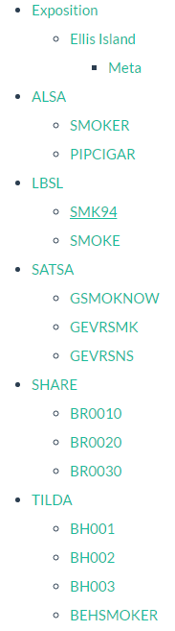
describe|
|harmonize
smoking
D
H
ALSA
dto
age
dto
D
H
LBLS
sex
D
H
Ellis
Island
education
SATSA
harmony
dto
D
H
marital
SHARE
D
H
…
TILDA
construct
D
H

Slide 8
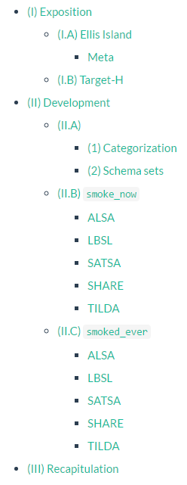
describe|
|harmonize
smoking
D
H
ALSA
dto
age
dto
D
H
LBLS
sex
D
H
Ellis
Island
education
SATSA
harmony
dto
D
H
marital
SHARE
D
H
…
TILDA
construct
D
H

Slide 9
prelude-describe|
|harmonize-sonata
smoking
D
H
ALSA
dto
age
dto
D
H
LBLS
sex
D
H
Ellis
Island
education
SATSA
harmony
dto
D
H
marital
SHARE
D
H
…
TILDA
construct
D
H

Slide 11
prelude|
|sonata
smoking
D
H
ALSA
dto
age
dto
D
H
LBLS
sex
D
H
Ellis
Island
education
SATSA
harmony
dto
D
H
marital
SHARE
D
H
…
TILDA
construct
D
H

Slide 12
prelude|
|sonata
smoking
D
H
ALSA
dto
age
dto
D
H
LBLS
sex
D
H
Ellis
Island
education
SATSA
harmony
dto
D
H
marital
SHARE
D
H
…
TILDA
construct
D
H

Slide 13
prelude|
|sonata
smoking
D
H
ALSA
dto
age
dto
D
H
LBLS
sex
D
H
Ellis
Island
education
SATSA
harmony
dto
D
H
marital
SHARE
D
H
…
TILDA
construct
D
H

Slide 14
dto
harmony
dto

Slide 16
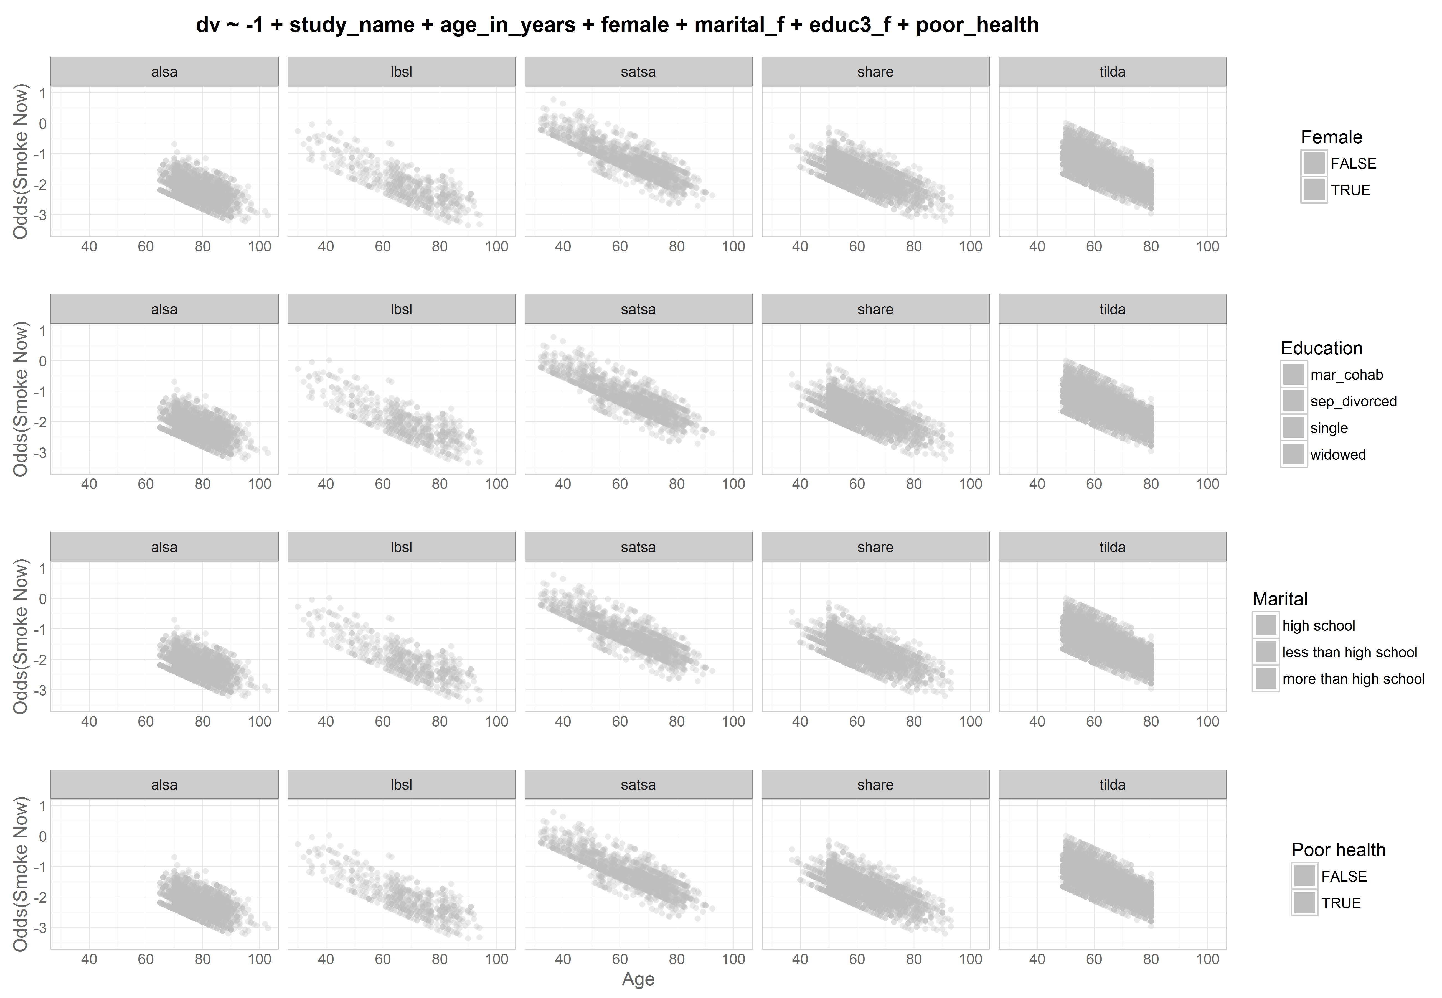
dto
harmony
dto

Slide 17
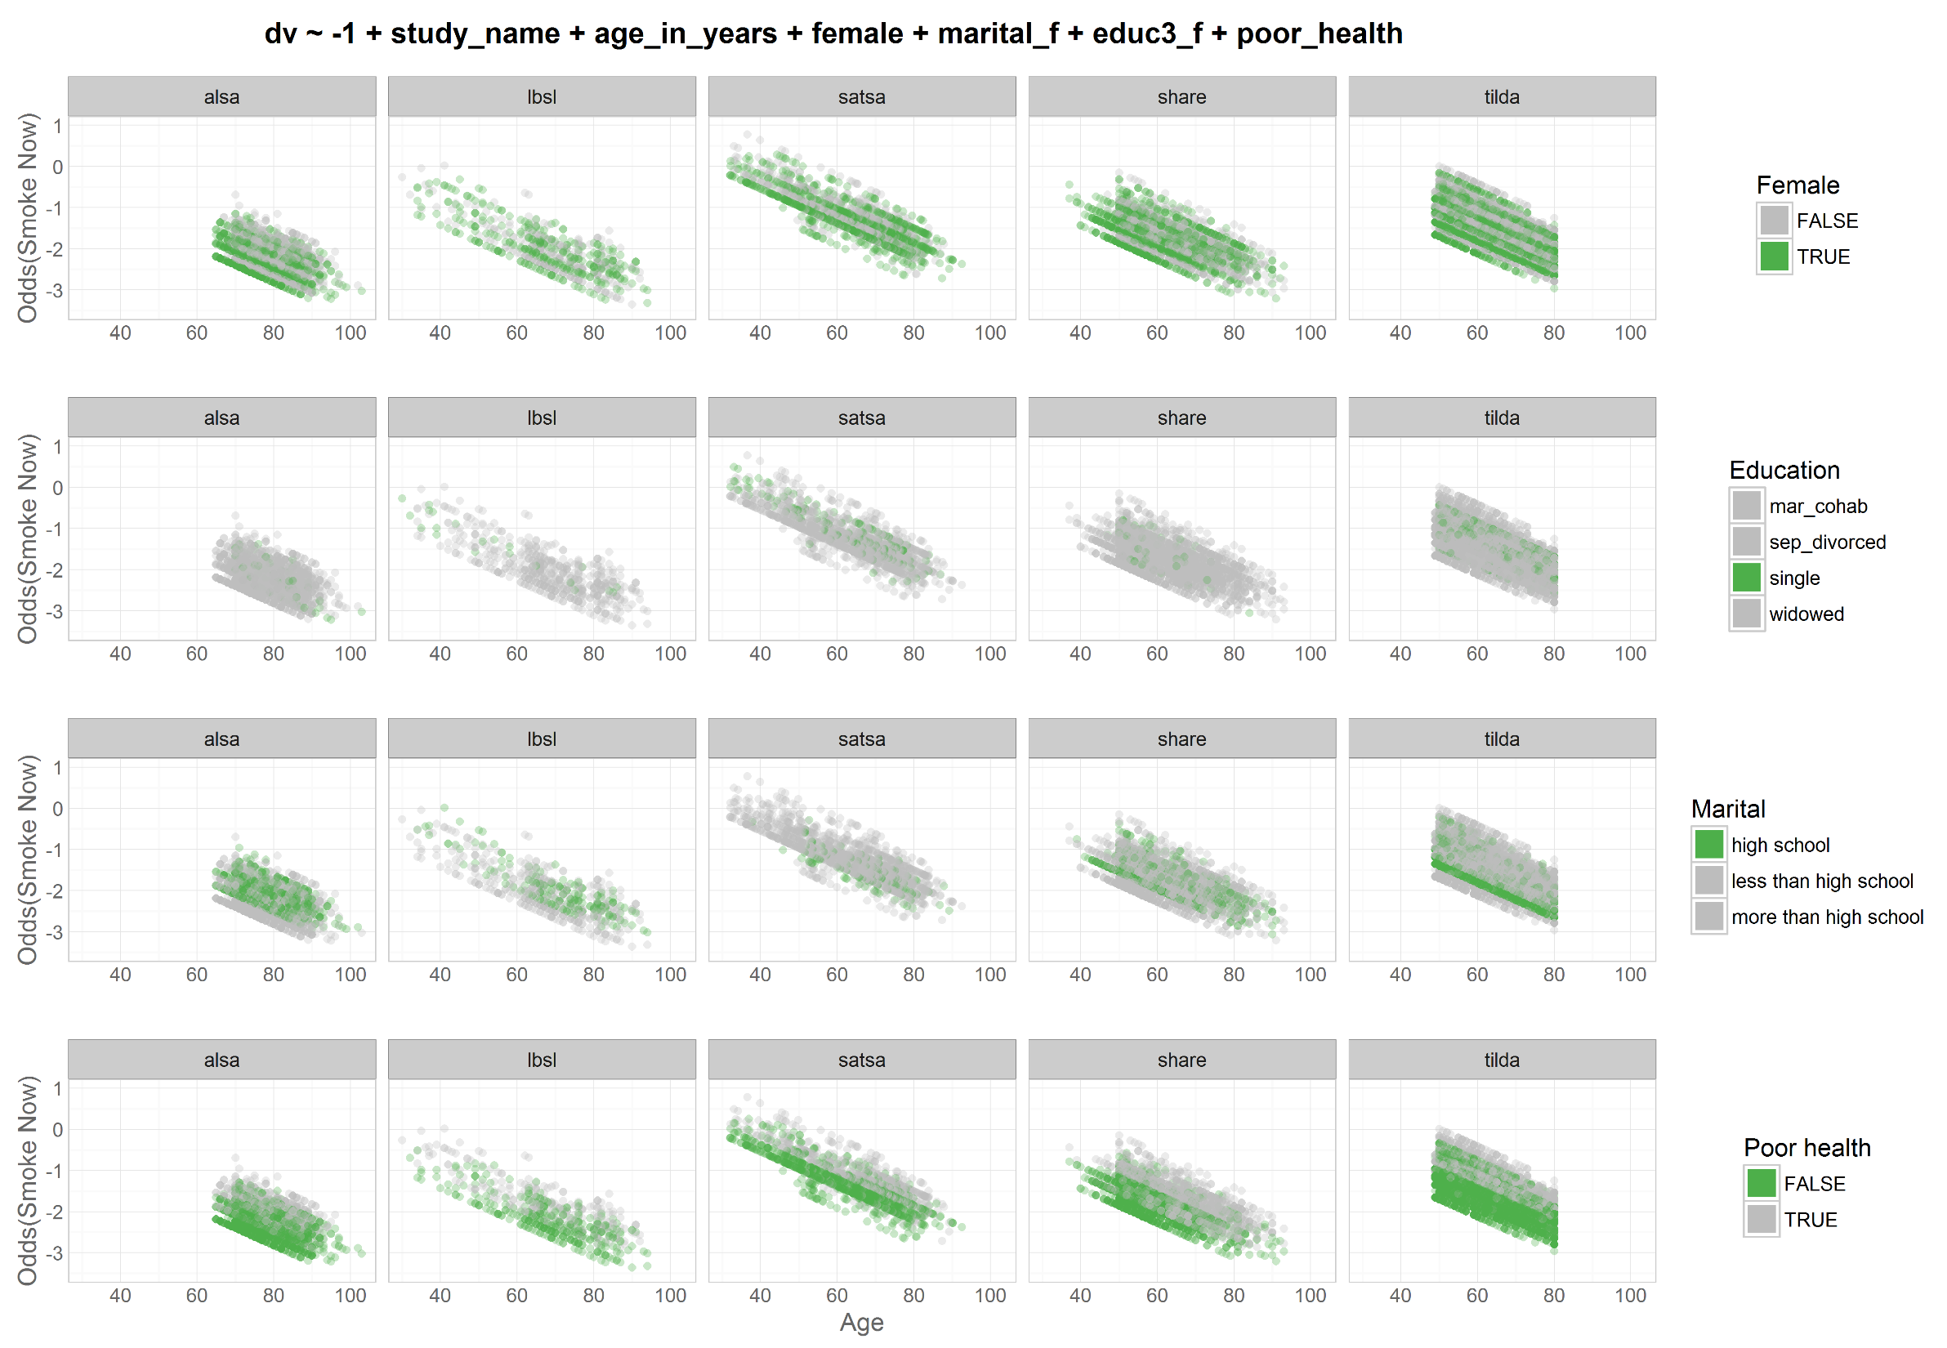
dto
harmony
dto

Slide 18
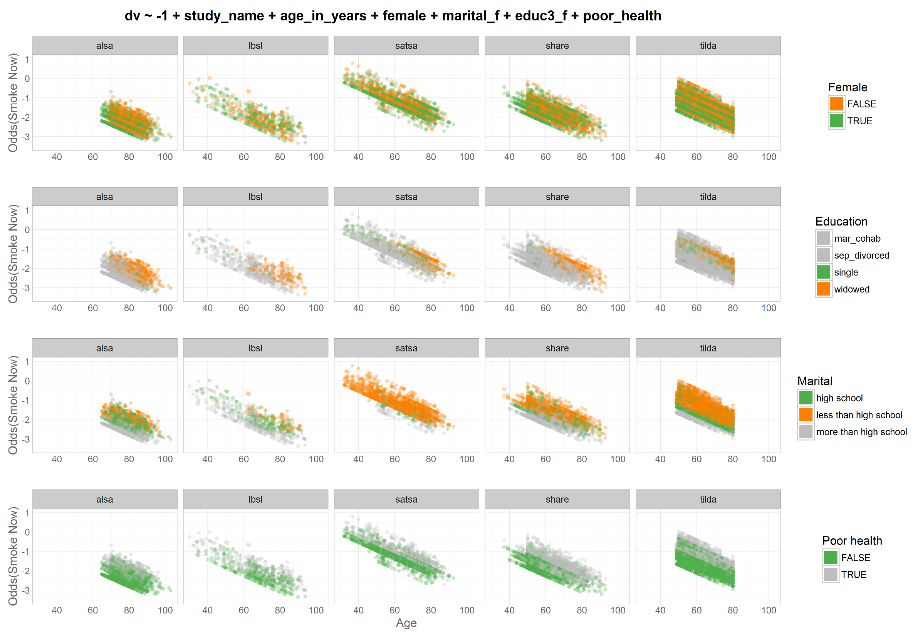
dto
harmony
dto

Slide 19
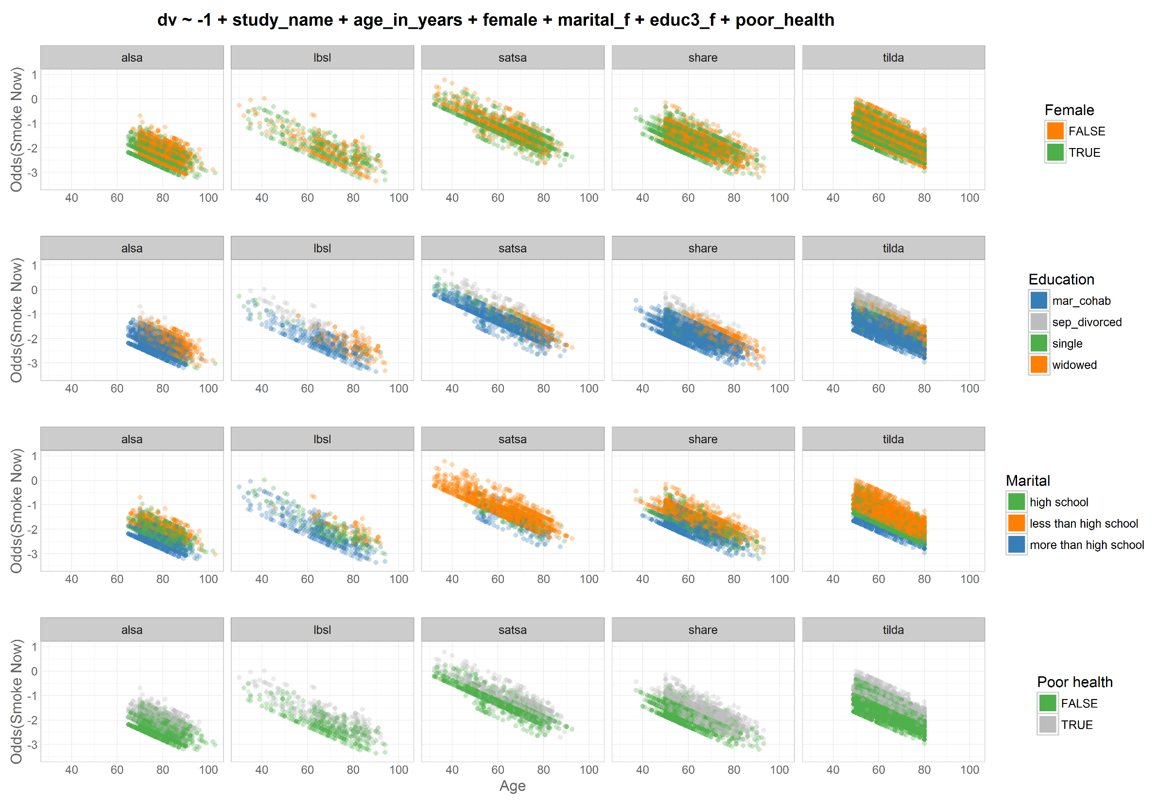
dto
harmony
dto

Slide 20
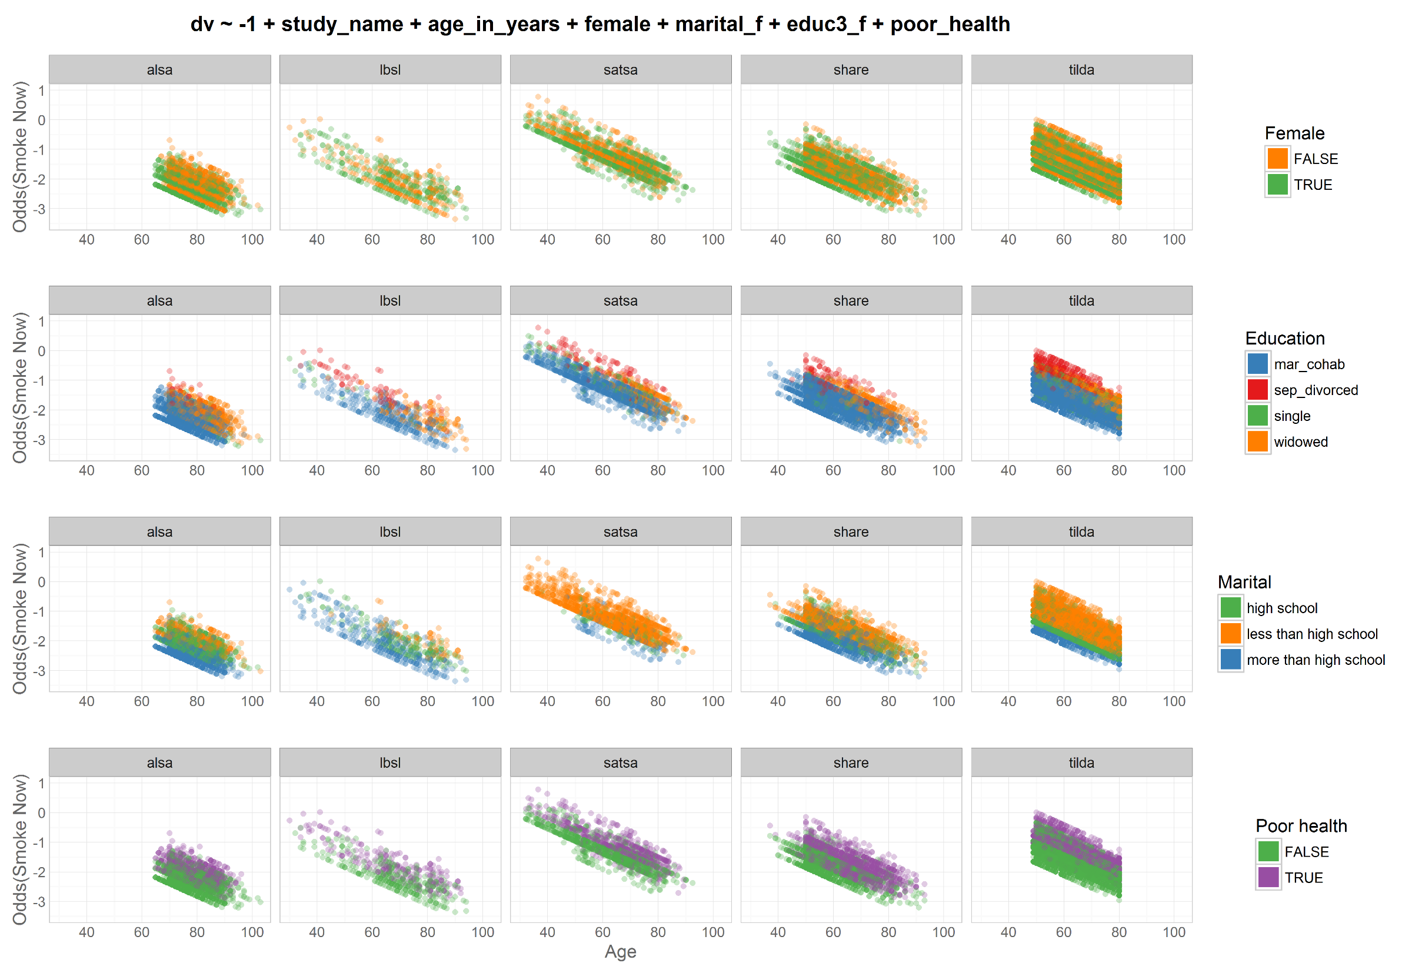
dto
harmony
dto

